Slide 1
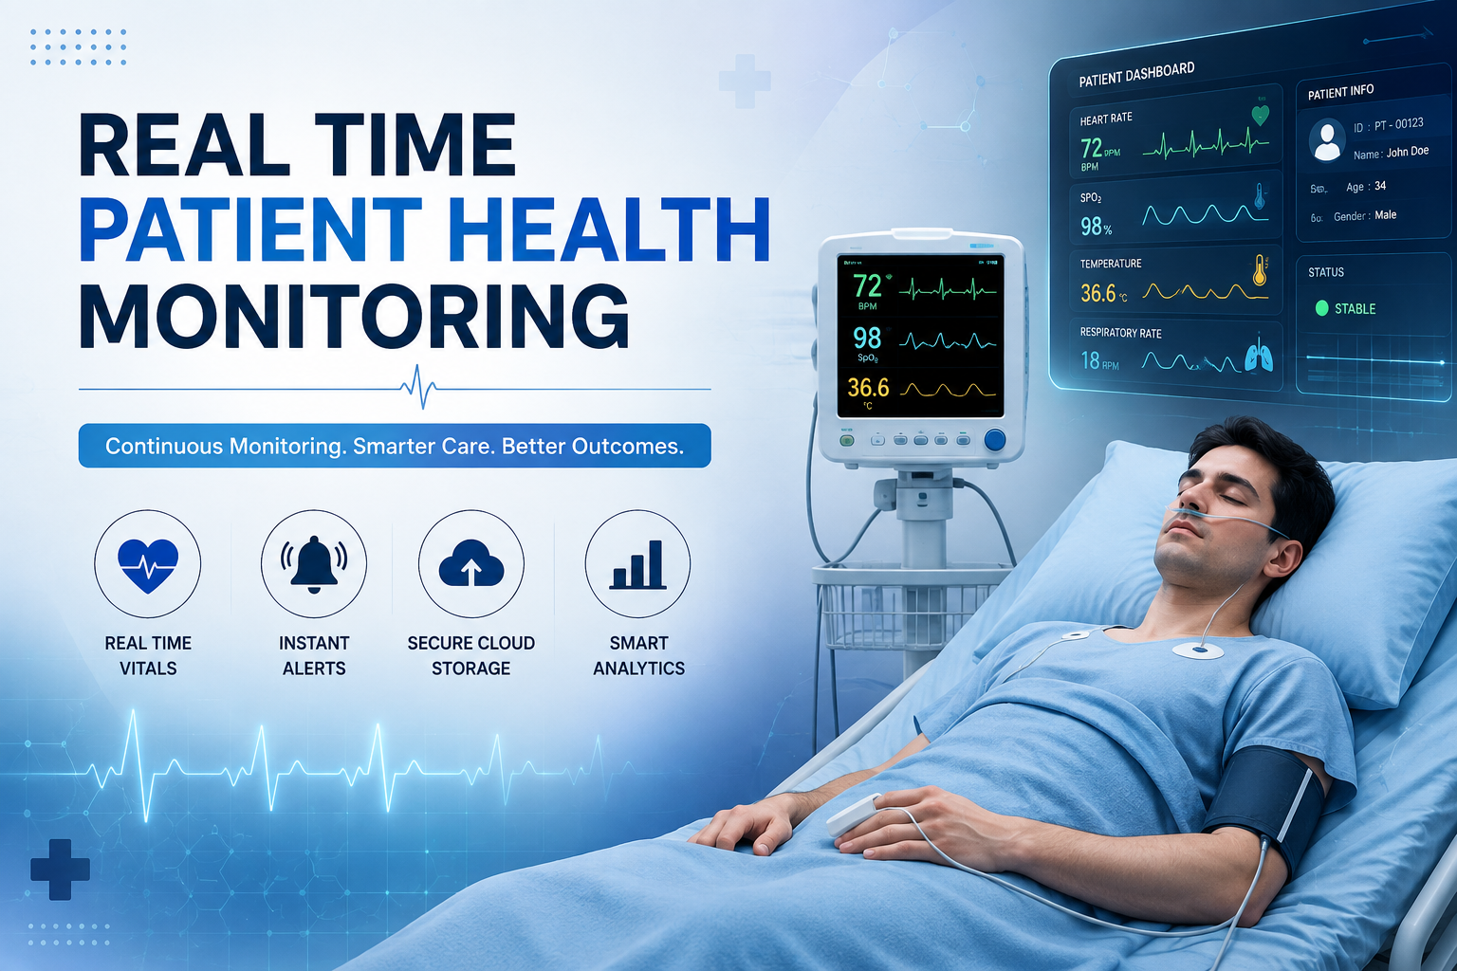
Semester 2-1 CPBL Review
REAL TIME PATIENT HEALTH MONITORING USING ESP 32
Presented by: B.GOPI KRISHNA REDDY(25491A5407)
BANDIKATLA POOJITHA(25491A5408)
BURRA KALYANI(25491A5410)
CH. YASWANTH(25491A5416)
CHANDURI REVATHI(25491A5418)
D.HEMA ANANTH KUMAR(25491A5420)
Under the Guidance of: Ms. H Yashaswini
Department: DATA SCIENCE
Project Domain:
Functional Domain: HEALTHCARE

Slide 2
PROJECT DOMAIN :
Healthcare Technology with IoT integration.
FUNCTIONAL DOMAIN:
Real‑time Patient Health Monitoring, Data Analysis, And Predictive
Diagnosis For Improved Medical Decision‑making.

Slide 3

PROBLEM IDENTIFICATION :
Problem Source:
Lack of continuous, intelligence, and remote patient monitoring
Reliance on hospital visits, manual observation, and periodic check‑ups
Stakeholders :
Patients → Need timely monitoring
Elderly → Require remote/fall detection
Family/Caregivers → Real‑time updates & alerts
IMPACT :
Delayed diagnosis → Higher mortality risk
Increased healthcare costs
Reduced efficiency in healthcare delivery
CURRENT CHALLENGES :
Technical → Limited real‑time monitoring
Operational → Dependence on manual observation

Slide 4
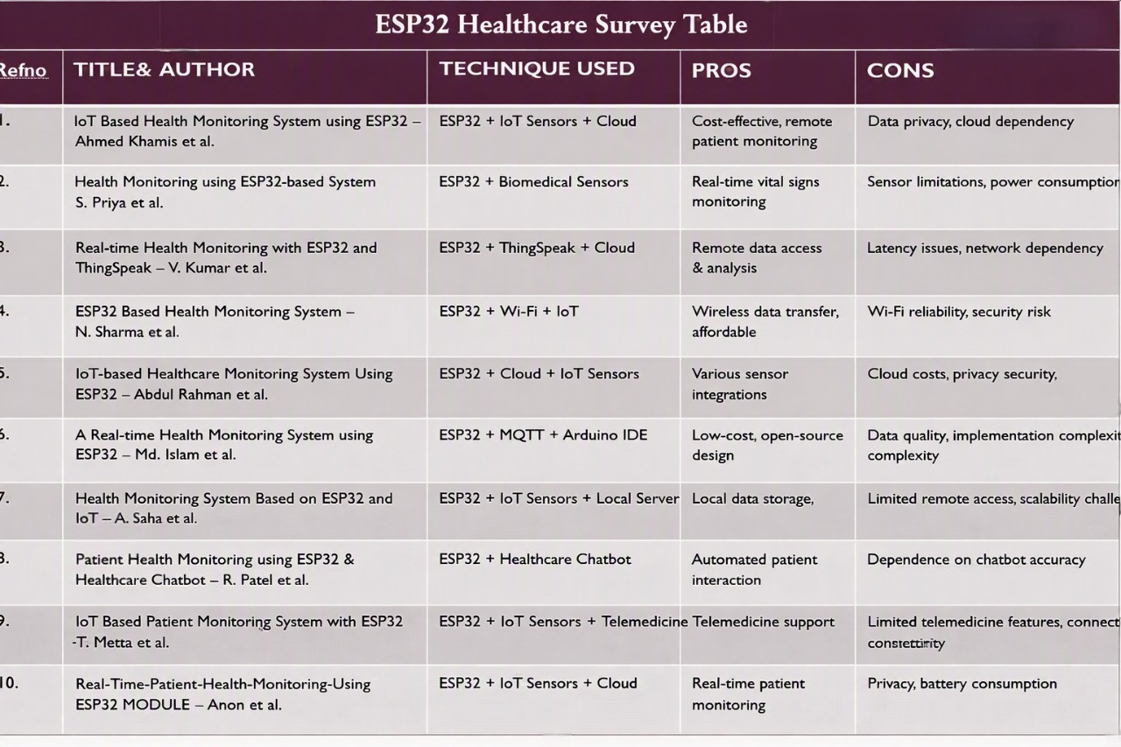
1
2
3
4
5
6
7
8
9
10

Slide 5
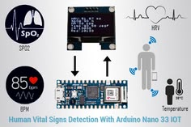
Research Gap & Motivation
🔍 Research Gap :
❤️ Current systems track only single health parameters.
📡 Poor multi‑sensor integration (ECG, pulse, temperature).
☁️ Limited real‑time cloud connectivity.
💰 Solutions are costly and less accessible.
🚀 Motivation :
🔧 Develop a low‑cost IoT health system with ESP32.
🔔 Enable real‑time alerts via LCD + buzzer.
🌐 Provide remote monitoring through cloud dashboards.
🏥 Support early abnormality detection for better healthcare.

Slide 6

OBJECTIVES :
Continuous monitoring
Early detection
Remote healthcare support
Reducing hospital visits
Improving decision‑making
Enhancing patient safety

Slide 7

Existing Solution Analysis :
Current Practices
Hospital bedside monitoring → Continuous ECG, HR, BP, SpO₂
Periodic health check‑ups → Routine hospital visits
Existing Products
Apple Watch → HR, ECG, SpO₂, fall detection
Fitbit Sense → HR, temperature trends, stress monitoring
Samsung Galaxy Watch → ECG, BP estimation, SpO₂ monitoring
Advantages :
Accurate vital sign measurement
Continuous hospital monitoring
Limitations :
Lack of integrated monitoring
Delayed emergency response
High cost issues

Slide 8

Proposed solution :
Methodology :
IoT sensors + microcontrollers for vitals
AI algorithms for anomaly detection
Cloud storage & mobile dashboards
Innovation :
Predictive AI alerts for emergencies
Integrated multi‑parameter monitoring
Remote access for rural/elderly patients
Expected Improvements :
Faster diagnosis & emergency response
Lower healthcare costs
Reduced hospital workload

Slide 9
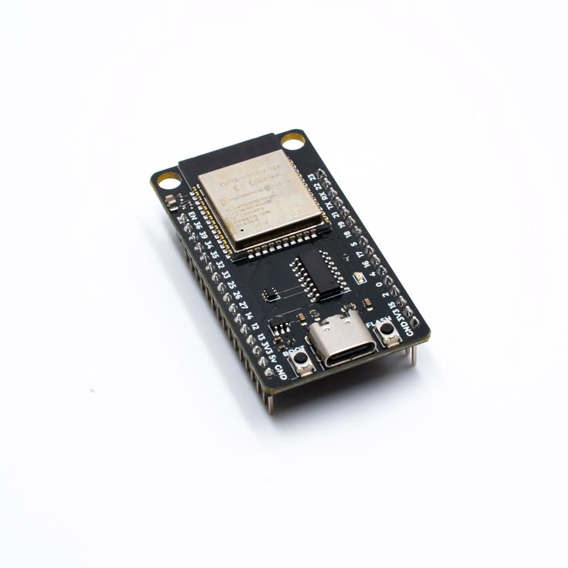
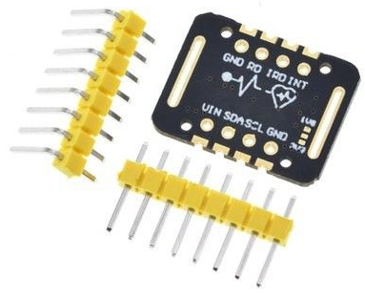
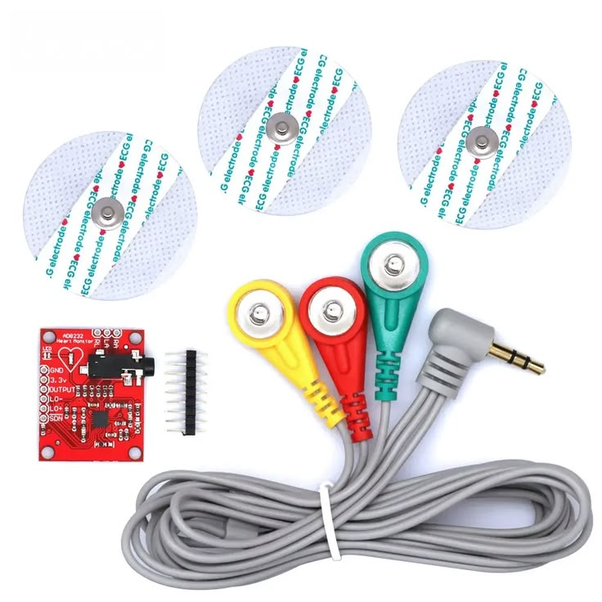
Subsystem Explanation - I
🌐 ESP32 Development Board :
A powerful microcontroller with built‑in Wi‑Fi and Bluetooth for IoT projects.
Supports multiple GPIOs, ADCs, and communication protocols for
connecting sensors and actuators.
❤️ Pulse/Heart Rate Sensor Module :
Detects changes in blood volume using light, producing signals that
represent heartbeats.
Outputs data via pins (SDA/SCL for I²C, INT for interrupts) to a microcontroller
for heart rate monitoring.
📈 ECG Sensor Kit :
Measures electrical signals from the heart using electrodes placed on the skin.
Sends amplified and filtered signals to a microcontroller for ECG waveform analysis.

Slide 10
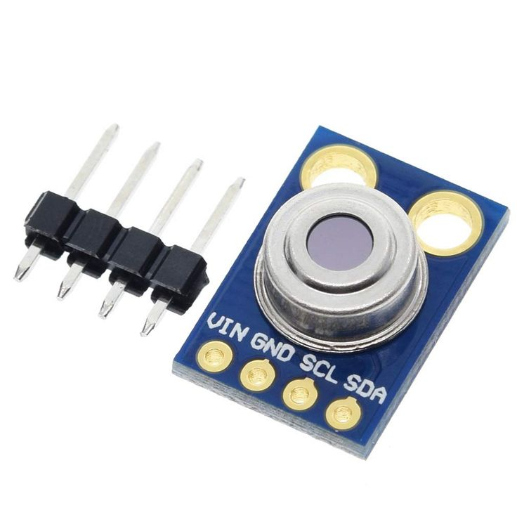
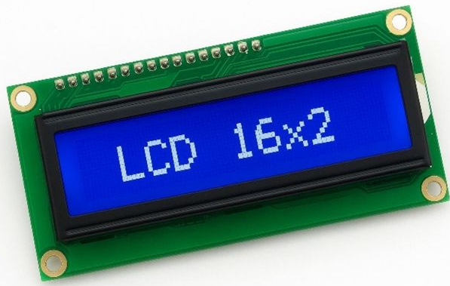
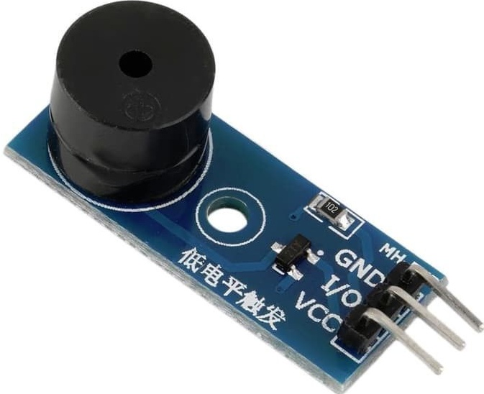
🌡️ MLX90614 Temperature Sensor :
Non‑contact body temperature measurement
📟 LCD 16x2 Display :
Displays alphanumeric characters (16 per line, 2 lines) for sensor readings
or messages.
Controlled via parallel or I²C interface, with adjustable backlight for visibility.
🔊 Buzzer Module :
Produces sound alerts when triggered by a microcontroller signal.
Can be set as active/passive, often used for alarms or notifications.
⚡ Power Supply Module
Provides a stable 5V / 3.3V regulated output to power the ESP32 and all connected modules.

Slide 11
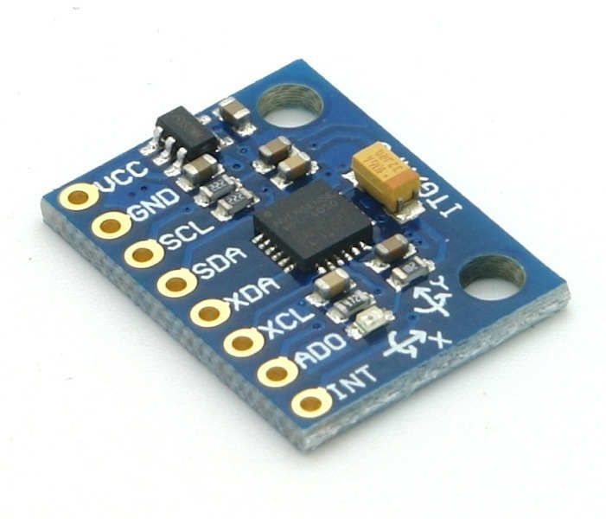
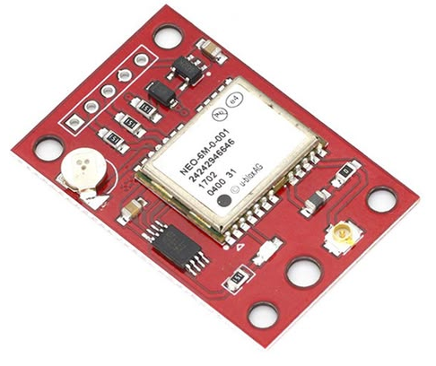
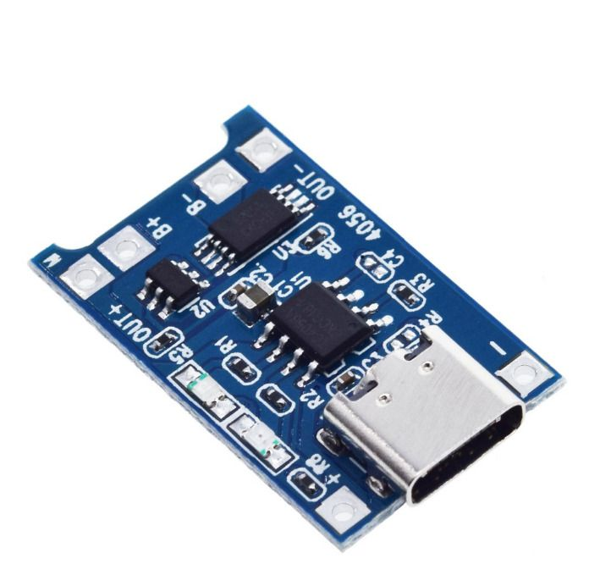
MPU6050 :
Detects motion and falls using accelerometer and gyroscope data.
NEO‑6M GPS :
Tracks patient location during emergencies for remote assistance.
TP4056 charging module :
Provides portable power supply with charging capability.

Slide 12
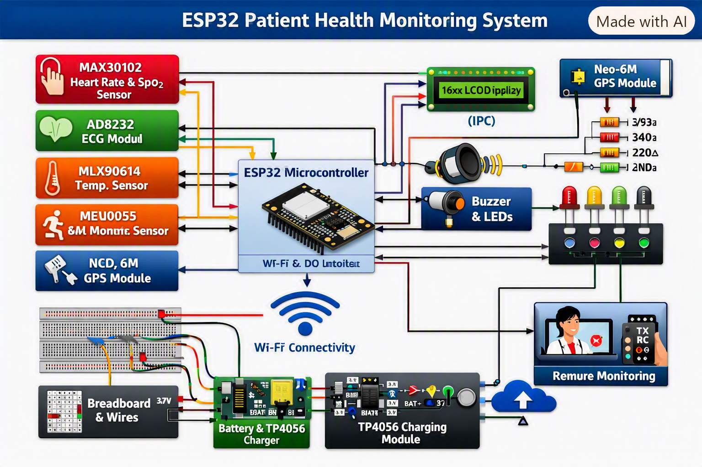
Subsystem Explanation - II
Software Flow & Integration
🖥️ Software Flow :
The ESP32 first initializes communication protocols (I²C, ADC, 1‑Wire, GPIO, Wi‑Fi) and then collects raw signals
from the heart rate, ECG, and temperature sensors. It processes these inputs by filtering noise, calculating
BPM, extracting ECG waveforms, and reading temperature values. Based on thresholds, it decides
whether to trigger alerts through the buzzer while showing live readings on the LCD.
Finally, the ESP32 syncs data to cloud platforms like Firebase or MQTT, enabling doctors or caregivers
to access patient information remotely in real time.
🔗 Integration :
Sensors → ESP32: Connected through I²C, ADC, and 1‑Wire pins.
ESP32 → LCD/Buzzer: GPIO controls display and alerts.
ESP32 → Cloud: Wi‑Fi transmits processed data for remote monitoring.
Cloud → User: Dashboard or app provides visualization and notifications.

Slide 13
Hardware & Software / Instrument Selection :
⚙️ Hardware (Sensors & Modules) :
Heart Rate Sensor
ECG Sensor Kit
MLX90614 Temperature Sensor
LCD 16x2 Display
Buzzer Module
ESP32 Development Board
Power Supply Module
📡 Communication :
I²C – LCD, heart rate sensor.
ADC (Analog Input) – ECG signals.
1‑Wire – MLX90614 temperature sensor.
GPIO – buzzer control.
Wi‑Fi (ESP32) – cloud sync and remote access.
💻 Software :
PlatformIO – coding and uploading firmware.
Libraries – Pulse sensor, ECG (AD8232), MLX90614 (OneWire).
Cloud Platforms – Firebase, Thingspeak, or MQTT broker for remote
monitoring.

Slide 14
📋 BOM :
ESP32 ×1
Heart rate sensor ×1
ECG kit ×1
MLX90614 (standard + waterproof) ×2
LCD 16x2 ×1
Buzzer ×1
Power supply ×1
Jumper wires, breadboard, connectors
🚀 PoC Plan :
Setup – Connect sensors, LCD, buzzer to ESP32 + power.
Firmware – Write ESP32 code for data & cloud sync.
Testing – Check sensor outputs, LCD display, buzzer alerts.
Cloud – Send data to Firebase/Thing speak, build dashboard.
Validation – Verify remote monitoring with sample inputs.

Slide 15
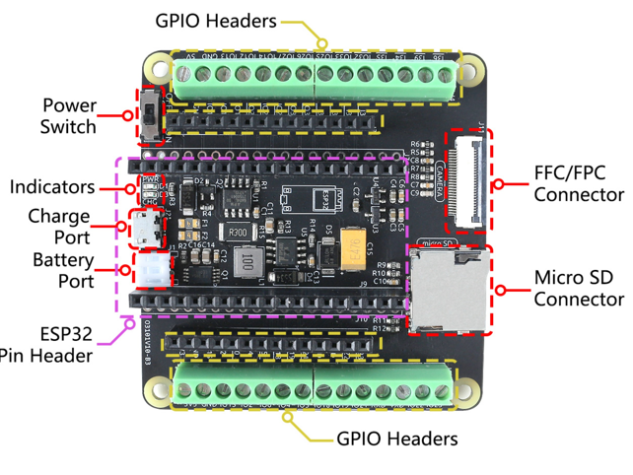
ESP32 DevKit — MCU & Wireless Gateway
Working principle:
Xtensa dual-core LX6 (240MHz) runs firmware, manages sensor data,
and provides Wi‑Fi/BLE connectivity to transmit telemetry to cloud or mobile apps.
Description & interface:
NodeMCU-style DevKit (30/38-pin). Interfaces: I²C, UART, ADC. Logic 3.3V;
USB 5V input.

Slide 16
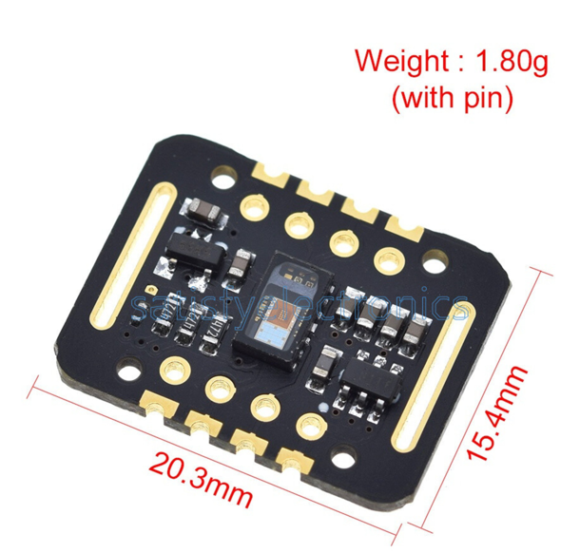
❤️MAX30102 Optical Oximeter — Pulse & SpO₂
Working principle:
Red (660nm) and IR (880nm) LEDs with photodiode measure light absorption through tissue;
algorithm derives pulse rate and SpO₂ from AC/DC ratios.
Description & interface:
I²C device (0x57), 18‑bit ADC, 3.3V rail. Small, low‑power optical sensor for continuous
monitoring.

Slide 17
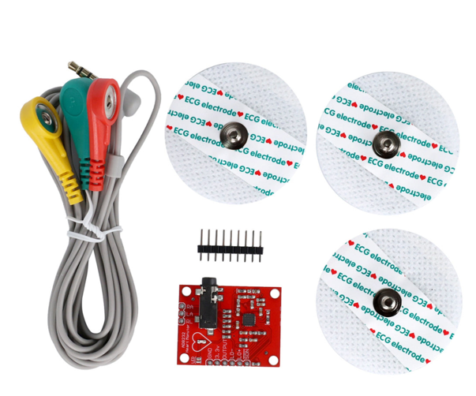
⚡ AD8232 Module — 3‑Lead ECG
Working principle:
Instrumentation amplifier (gain≈100) conditions small biopotential signals from electrodes;
outputs analog ECG waveform for ADC sampling.
Analog output to ADC1 (GPIO34) to avoid ADC2/Wi‑Fi conflicts. Leads‑off detect; 3.3V supply.

Slide 18
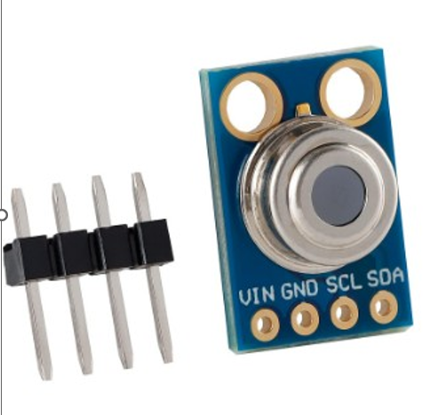
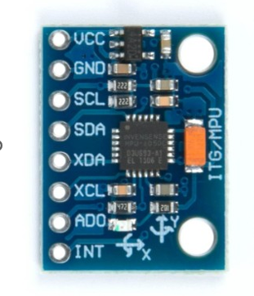
🌡️MLX90614 & MPU6050 — Temperature & Motion
MLX90614 — Infrared Temperature: Non‑contact IR pyrometer with ±0.2°C
medical accuracy; reads surface temperature over I²C (0x5A). Optimal 2–5cm distance.
MPU6050 — 6‑DOF IMU: 3‑axis accel + 3‑axis gyro with DMP for fall/impact detection;
communicates via I²C (0x68).

Slide 19
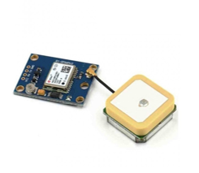
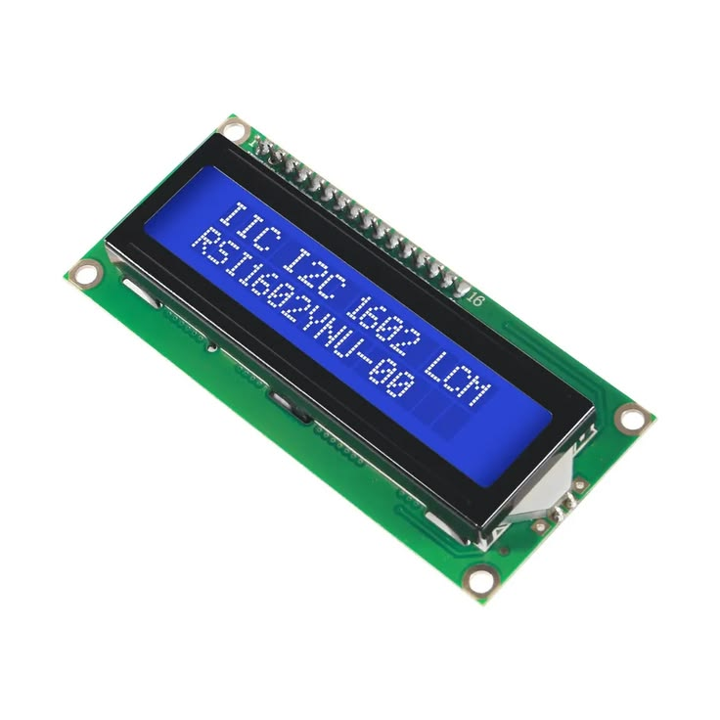
NEO‑6M GPS & 16×2 LCD — Location & Display
NEO‑6M — Location Tracking:
UART2 serial (GPIO16 RX2 / GPIO17 TX2) at
9600 baud outputs NMEA‑0183 strings for geolocation and time. 50 channels.
16×2 LCD + I²C:
PCF8574 backpack provides I²C (0x27/0x3F) interface to
display vitals locally; powered with 5V VIN for contrast.

Slide 20
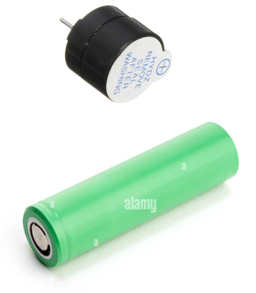
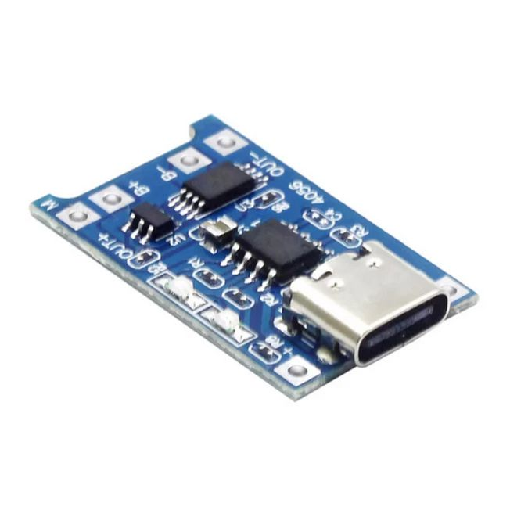
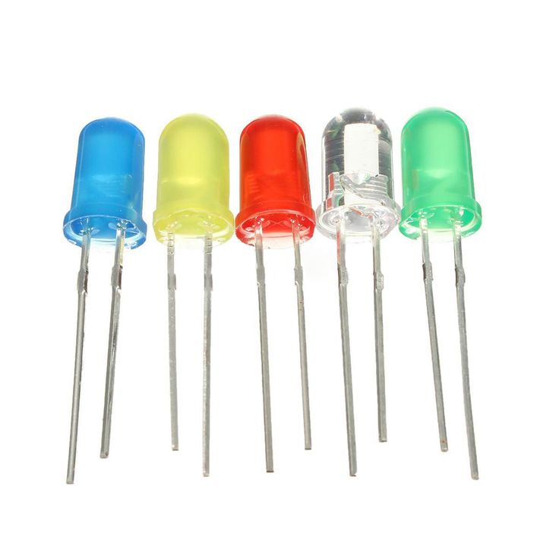
Buzzer, LEDs, Battery
Buzzer & Battery
Buzzer & LEDs:
Digital GPIO drives 5V active buzzer (~20mA) and visual LEDs (with resistors) for immediate local alerts.
Battery + TP4056:
3.7V 18650 Li‑ion (2200–2600mAh) with TP4056 charger and DW01A protection for portable operation. Micro‑USB/Type‑C charging.
TP4056
LED

Slide 21
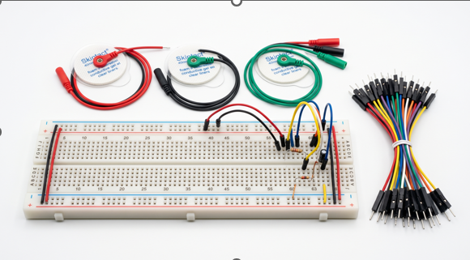
Prototyping & Accessories — Wiring, Electrodes.
Breadboard & Wires:
Solderless 830‑point breadboard and jumper wires for rapid
prototyping.
Electrodes & Misc.:
Ag/AgCl gel pads, 3‑lead snap connector and cables for
ECG acquisition.

Slide 22
Conclusion
The REAL TIME PATIENT HEALTH MONITORING USING ESP32 combines IoT, AI, and cloud technology to monitor patient health in real time. It enables early detection of health issues, provides instant alerts, and supports remote healthcare. This low-cost and scalable solution improves patient care and has strong potential for future enhancements such as wearable devices and advanced AI-based disease prediction.

Slide 23
THANK YOU

